Slide 1
Software Development Process Models
03-04-2018

Slide 2
Software Development Process
Today we have reached a situation where you have control over everything at the tip of your fingers. Technology has developed beyond imagination. All thanks to the software development industry!
The world of software development is something that is limitless.
Technology is a perfect blend of innovation and ideation that conceptualizes to form a platform, which is suitable for operating various software developments taking place.
In fact, the methodology meant for software development is considered as a structure used for planning and controlling the procedure of creating a specialized software.
Certainly, these innovative methods are concerned with highlighting the process of software development, which does not involve the usage of any technical aspect.
The only matter considered is proper planning for the purpose of highly integrated software development.
The simple tenacity of these procedures is to offer customized software development as per the requirements.

Slide 3
12 Best Software Development Process Models
Waterfall Model
Prototype Methodology
Agile Software Development Methodology
Rapid Application Development
Dynamic System Development Model
Spiral Model
Extreme Programming Model
Feature Driven Development
Joint Application Development
Lean Development
Rational Unified Process
Scrum Development

Slide 4
1. Water Fall Model
If you are into software development at some point or the other, you would have bumped into the Waterfall Model.
Considered as the traditional method of explaining the software development process in software engineering, waterfall model happens to clarify the process into a linear flow with a specified sequence to let the users understand that further level is made progressive on completion of the previous one.
Moreover, this methodology also talks about the fact that going back to deal with the changes is not possible.

Slide 5
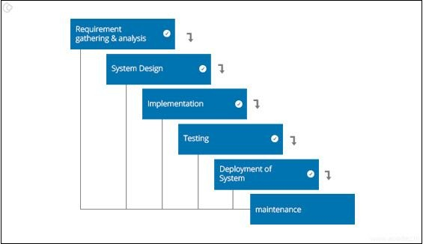
1. Waterfall Development Model

Slide 6
1. Waterfall Development Model
Pros:
Easy to understand and functional
Simple enough to handle as model is rigid
Saves significant amount of time
Allows for easy testing and analysis
Cons:
Only matches precise needs
Not applicable for maintenance projects
No option to know possible outcome of a project
Not excellent for long and ongoing projects

Slide 7
2. Prototype Methodology
It is a specialized software development procedure that initiates developers towards making only the sample of the resolution to validate its functional essence to the customers and make essential changes before creating the authentic final solution.
In fact, the best part of this methodology is that it tends to resolve a set of diversifying issues occurring with the waterfall method.

Slide 8
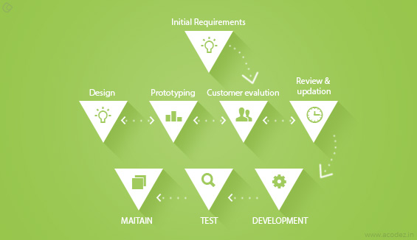
2. Prototype Methodology

Slide 9
2. Prototype Methodology
Pros:
Gives clear idea about the functional process of the software
Reduces the risk of failure in a software functionality
Assists well in requirement gathering and the overall analysis
Cons:
Chances of extension in management cost
Excessive involvement of client can affect processing
Too many changes affect the workflow of the software

Slide 10
3. Agile Software Development Methodology
As an innovative approach, the agile software development methodology is used for articulating a well-organized project management procedure allowing for recurrent alterations.
Certainly, such type of a methodology is one theoretical outline for undertaking several software engineering projects.
Another good thing about it is that it minimizes peril by creating software in short time boxes, known as iterations, which happen to last from one week to one month.

Slide 11
3. Agile Software Development Methodology
Pros:
Adaptive approach that responds to changes favorably
Allows for direct communication to maintain transparency
Improved quality by finding and fixing defects quickly and identifying expectation mismatches early.
Cons:
Focuses on working with software and lacks documentation efficiency
Chances of getting off-track as outcome are not clear

Slide 12
4. Rapid Application Development Methodology
Aimed at providing quick results, rapid application development is meant to give excellent development processes with the assistance of other development approaches.
It is created to take the maximum advantage from the development software.
Undoubtedly, it is designed to augment the workability of the whole software development procedure for highlighting the participation of an active user.

Slide 13
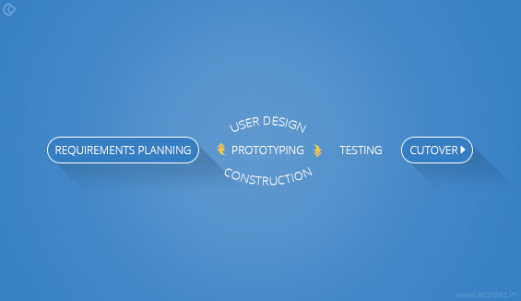
4. Rapid Application Development Methodology

Slide 14
4. Rapid Application Development Methodology
Pros:
Makes the entire development process effortless
Assists client in taking quick reviews
Encourages feedback from customers for improvement
Cons:
Dependent on the team for performance
Works on modularized system confined on this methodology
Requires extremely skilled personnel to handle complexities
Not applicable for the small budgeted projects

Slide 15
5. Dynamic System Development Model
Authentically formulated and derived from the rapid application development methodology, it is an iterative and incremental approach that focuses on the involvement of the user.
The task of this methodology is to provide software development systems within the specified time frame and the allocated budget.
The very reason why it is quite in demand in the world of software development.

Slide 16
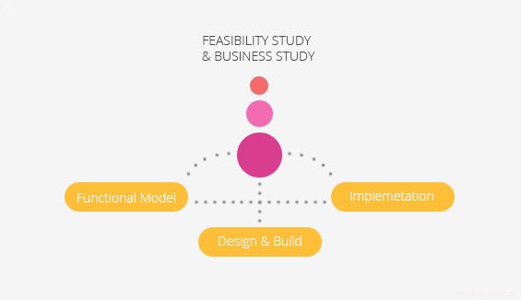
5. Dynamic System Development Model

Slide 17
5. Dynamic System Development Model
Pros:
Users getting a grip of the software development process
Functionality deliverables are quick
Offers easy access to end users by the developers
Cons:
This methodology is costly to implement
Not suitable for small organizations

Slide 18
6. Spiral Model
Being a highly sophisticated design, it is meant to reduce the early risks in the project.
As per the process going by, the developers initiate on a smaller level and explore the included risks in it.
Further to this, the developers are intended towards crafting a plan for iterating of the spiral.
The accomplishment of any Spiral Lifecycle model is based on consistent, observant, and conversant management of the project.

Slide 19
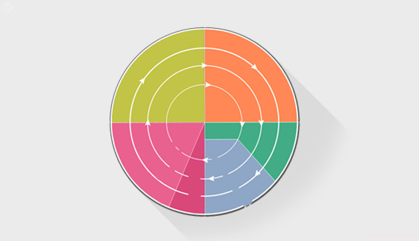
6. Spiral Model

Slide 20
6. Spiral Model
Pros:
Risk factors are considerably reduced
Excellent for large and complex projects
Allows for additional functionality later
Suitable for highly risky projects with varied business needs
Cons:
Costly model in software development
Failure in risk analysis phase may damage the whole project
Not appropriate for low-risk projects
Might get continued and never finish

Slide 21
7. Extreme Programming Methodology
As an agile software engineering methodology, extreme programming methodology is presently known as XP methodology.
It is chiefly used for crafting software within a very unbalanced atmosphere.
It enables greater tractability within the modelling procedure.
The foremost aim of this XP model is to reduce the cost of software essentialities.
It is fairly mutual in the XP model that the price of altering the requirements on future stage in the project can be really whooping.

Slide 22
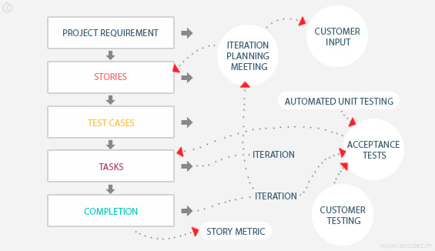
7. Extreme Programming Methodology

Slide 23
7. Extreme Programming Methodology
Pros:
It lays focus on customer involvement
Establishes rational plans and schedules
Developers are exceptionally committed to the project
Equipped with modernistic methods for quality software
Cons:
Effectiveness depends on the people involved
Requires frequent meeting for development raising total costs
Necessitates for excessive development changes
Exact possibilities and future outcomes are really unknown

Slide 24
8. Feature Driven Development
Being an iterative methodology for software development, it is aimed at serving a large number of teams working on a project based on object-oriented technology.
This sort of model is decent for companies that are passing on from a phase-based method to an iterative approach.
It is already known as a FDD methodology and is highly functionable and creative enough to deal with varied complexities.

Slide 25
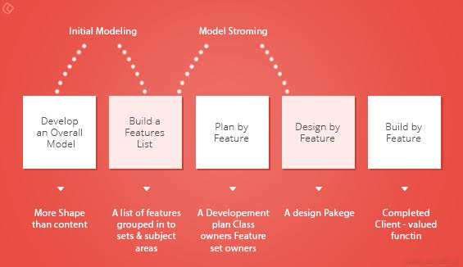
8. Feature Driven Development

Slide 26
8. Feature Driven Development
Pros:
Moves bigger projects with continuous success
Easiest 5 procedures bring outcome in a better manner
Built on pre-set standards of software development, it is programmed for easy development
Cons:
Not suitable for smaller projects and single developer
Highly dependable on the leading developers, necessitating for the complete structure
No written document provided to software owner

Slide 27
9. Joint Application Development Methodology
The Joint Application Development Methodology is a requirements-classification and user-interface expansion approach that necessitates for the end-users, clients and developers attend a powerful off-site conference to accentuate and confirm software system.
This methodology serves towards including the client in the design and expansion of an application.
This is effortlessly proficient through a sequence of concerted workshops known as JAD sessions.
It tends to lay emphasis on the business difficulty rather than methodical details.

Slide 28
9. Joint Application Development Methodology
Pros:
Allows for simultaneous congregation and alliance of excessive information.
Produces huge amount of valuable information in short period
Immediate resolving of differences with suitable assistance
Provides forum to explore multiple points
Cons:
Takes excessive amount of time for planning and scheduling
Requires significant investment of time and effort
Calls for highly trained experts, which is tough to find

Slide 29
10. Lean Development Methodology
As a technical advancement, Lean Development model lays emphasis on the formation of effortlessly manageable software.
This exquisitely designed development technique is more deliberately engrossed than any other form of agile methodology.
The objective of this procedure is to improve the software in one-third of the time, with very restricted budget, and very fewer amount of essential workflow.

Slide 30
10. Lean Development Methodology
Pros:
Lower budget & time requirements
Allows for delivery of product early
Cons:
The workability of the team decides success of software development process
Unsuitable business analyst can be severely problematic
Excessive flexibility leads developer to lose focus

Slide 31
11. Rational Unified Process Methodology
Smartly called as RUP, Rational Unified Process methodology powers software development using rational tools.
This methodology segregates the expansion process into four different stages that each includes business modeling, scrutiny and design, enactment, testing, and disposition.
This is an object-based and web-empowered program growth methodology.
The model tends to assist software developer for stating guidelines, templates, and specimens for all features and stages of software development.

Slide 32
11. Rational Unified Process Methodology
Pros:
Lays high focus on precise documentation
Removes project risks linked with client evolving needs
Very less requirement for integration
Cons:
Needs excessively expert software developer
Development procedure of the methodology is complicated
Integration might cause confusion
Very complicated to understand

Slide 33
12. Scrum Development Methodology
SCRUM is the most widely preferred agile software development approach.
(Likewise, KANBAN is a process that helps teams to collaborate and work effectively.)
Basically, this excellent development is suitable for those development projects that are constantly altering or extremely developing requirements.
The Scrum Software development model initiates with an ephemeral planning, conference and completes with a concluding review.
This growth methodology is used for prompt development of software that happens to include a series of iterations to generate required software.
It is a perfect approach because it effortlessly brings on track the deliberate progressing projects.

Slide 34

12. Scrum Development Methodology

Slide 35
12. Scrum Development Methodology
Pros:
Decision making lies in the hands of the team
Business requirement document is considered insignificant
Lightly controlled method empathizing with constant updating
Cons:
The processing method suffers because of wavering costs
Not suitable for big sized projects
Requires highly expert team, which has no place for novices

Slide 36
Summing Up!!!
Technology has paved way for exclusive developments and software development procedures are not different.
The main thing in this aspect is that it deals with a variety of complexities, which requires expert handling.
Software development has specified methodologies that work on certain platforms, which allows them freedom to operate.
This calls for high-quality performance under the guidance of professionals, who have years of experience in handling technical issues with efficiency.
With varied forms of methodologies applicable to a different set of software development projects, the developers have loads of options to create excellently working software.

Slide 37
Summing Up!!!
It is the world of technology that everyone is looking, and the constant changes have led to various software developments.
It is the technique of creating useful software that adds value to the overall business procedure and creates ways for technical methodologies.
The essential factor of developing high-quality software is that they simplify complex procedure; but, requires an extensive way of dealing with technicalities and expert knowledge.
It is the support of experts that such software works efficiently; otherwise, they tend to spoil the entire process.

